Slide 1
MALLA REDDY UNIVERSITY
(MR22-1CS0108) CLOUD COMPUTING
UNIT I
Introduction: Definition, characteristics, components, Cloud service provider, the role of networks in Cloud computing, Cloud deployment models- private, public & hybrid, Cloud service models, multitenancy.
Virtualization: Virtualization technologies and Architectures, Desktop Virtualization, Server virtualization, Storage virtualization, Network virtualization, Service virtualization, Data Virtualization. Hypervisors: KVM, Xen, VMware hypervisors and their features.

Slide 2
Definition of Cloud Computing
Cloud computing meaning in a simple term, it is delivering the computing service which includes
high end servers,
storage for the service opted,
managing the database,
networking,
necessary software used for the purpose, analytics & intelligence,
running over an internet connection.
Cloud computing is the on-demand delivery of IT resources over the Internet with pay-as-you-go pricing. These resources run on server computers that are located in large data centers in different locations around the world. When you use a cloud service provider like AWS, that service provider owns the computers that you are using. These resources can be used together like building blocks to build solutions that help meet business goals and satisfy technology requirements.

Slide 3
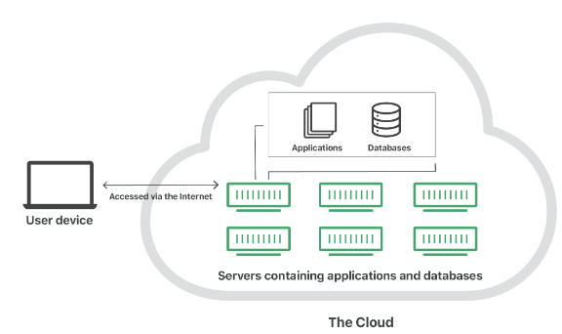
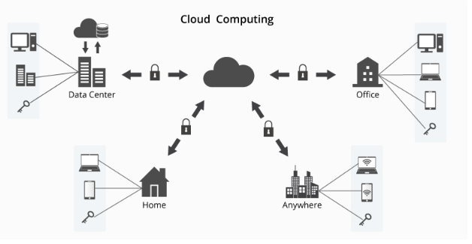
"The cloud" refers to servers that are accessed over the Internet, and the software and databases that run on those servers. Cloud servers are located in data centers all over the world. By using cloud computing, users and companies do not have to manage physical servers themselves or run software applications on their own machines.
For businesses, switching to cloud computing removes some IT costs and overhead: for instance, they no longer need to update and maintain their own servers, as the cloud vendor they are using will do that.
This especially makes an impact for small businesses that may not have been able to afford their own internal infrastructure but can outsource their infrastructure needs affordably via the cloud.

Slide 4
The cloud can also make it easier for companies to operate internationally, because employees and customers can access the same files and applications from any location.
The cloud enables users to access the same files and applications from almost any device, because the computing and storage takes place on servers in a data center, instead of locally on the user device.
Example
This is why a user can log in to their Instagram account on a new phone after their old phone breaks and still find their old account in place, with all their photos, videos, and conversation history.
It works the same way with cloud email providers like Gmail or Microsoft Office 365, and with cloud storage providers like Dropbox or Google Drive.

Slide 5
Who is using cloud computing?
Organizations of every type, size, and industry are using the cloud for a wide variety of use cases, such as data backup, disaster recovery, email, virtual desktops, software development and testing, big data analytics, and customer-facing web applications.
For example,
Healthcare companies are using the cloud to develop more personalized treatments for patients. Financial services companies are using the cloud to power real-time fraud detection and prevention.
And video game makers are using the cloud to deliver online games to millions of players around the world.

Slide 6
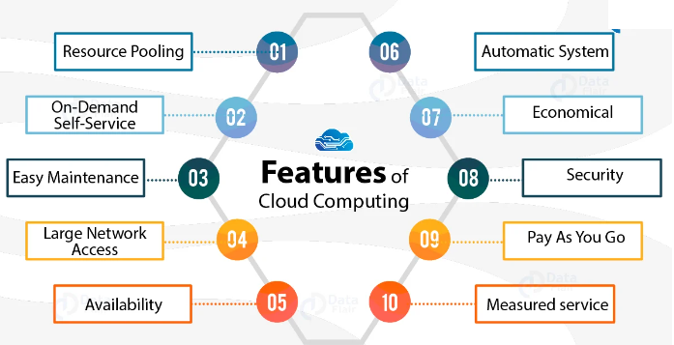
Features / Properties / Characteristics of Cloud Computing
1. Resources Pooling
The IT resource (e.g., networks, servers, storage, applications, and services) present are shared across multiple applications and occupant in an uncommitted manner. Multiple clients are provided service from a same physical resource.
2. On-Demand Self-Service
The Cloud computing services does not require any human administrators, user themselves are able to provision, monitor and manage computing resources as needed.
3. Easy Maintenance
The servers are easily maintained and the downtime is very low. Cloud Computing comes up with an update every time by gradually making it better.
4. Large Network Access
The user can access the data of the cloud or upload the data to the cloud from anywhere just with the help of a device and an internet connection.
5. Availability
The capabilities of the Cloud can be modified as per the use and can be extended a lot. It analyzes the storage usage and allows the user to buy extra Cloud storage if needed for a very small amount.

Slide 7
Features / Properties / Characteristics of Cloud Computing
6. Automation
Cloud computing services are often highly automated, allowing users to deploy and manage resources with minimal manual intervention.
7. Economical
In cloud computing, clients need to pay the third-party for the space used by them. More often, some space is allocated for free.
8. Security
It creates a snapshot of the data stored so that the data may not get lost even if one of the servers gets damaged.
The data is stored within the storage devices, which cannot be hacked and utilized by any other person. The storage service is quick and reliable.
9. Pay as you go
In cloud computing, the user has to pay only for the service or the space they have utilized. There is no hidden or extra charge which is to be paid. The service is economical and most of the time some space is allotted for free.
10. Measured service:
The resource utilization is tracked for each application and occupant, it will provide both the user and the resource provider with an account of what has been used. This is done for various reasons like monitoring billing and effective use of resource.

Slide 8
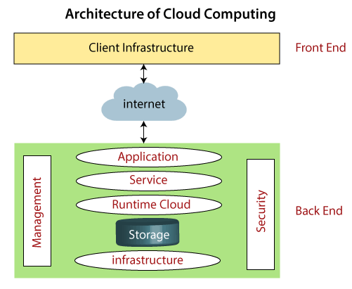
Components of Cloud Computing Architecture
cloud computing technology is used by both small and large organizations to store the information in cloud and access it from anywhere at anytime using the internet connection.

Slide 9
Cloud computing architecture is a combination of service-oriented architecture and event-driven architecture.
Cloud computing architecture is divided into the following two parts -
Front End
Back End
Front End
The front end is used by the client. It contains client-side interfaces and applications that are required to access the cloud computing platforms. The front end includes web servers (including Chrome, Firefox, internet explorer, etc.), thin & fat clients, tablets, and mobile devices.
Back End
The back end is used by the service provider. It manages all the resources that are required to provide cloud computing services. It includes a huge amount of data storage, security mechanism, virtual machines, deploying models, servers, traffic control mechanisms, etc.

Slide 10
Components of Cloud Computing Architecture
There are the following components of cloud computing architecture -
1. Client Infrastructure
Client Infrastructure is a Front end component. It provides GUI (Graphical User Interface) to interact with the cloud.
2. Application
The application may be any software or platform that a client wants to access.
3. Service
A Cloud Services manages that which type of service you access according to the client’s requirement.
Cloud computing offers the following three type of services:
Software as a Service (SaaS) – It is also known as cloud application services.
Mostly, SaaS applications run directly through the web browser means we do not require to download and install these applications.
Some important example of SaaS is given below –
Example: Google Apps, Salesforce Dropbox, Slack, Hubspot, Cisco WebEx.

Slide 11
ii. Platform as a Service (PaaS) – It is also known as cloud platform services. It is quite similar to SaaS, but the difference is that PaaS provides a platform for software creation, but using SaaS, we can access software over the internet without the need of any platform.
Example: Windows Azure, Force.com, Magento Commerce Cloud, OpenShift.
iii. Infrastructure as a Service (IaaS) – It is also known as cloud infrastructure services. It is responsible for managing applications data, middleware, and runtime environments.
Example: Amazon Web Services (AWS) EC2, Google Compute Engine (GCE), Cisco Metapod.
4. Runtime Cloud
Runtime Cloud provides the execution and runtime environment to the virtual machines.
5. Storage
Storage is one of the most important components of cloud computing. It provides a huge amount of storage capacity in the cloud to store and manage data.

Slide 12
6. Infrastructure
It provides services on the host level, application level, and network level.
Cloud infrastructure includes hardware and software components such as servers, storage, network devices, virtualization software, and other storage resources that are needed to support the cloud computing model.
7. Management
Management is used to manage components such as application, service, runtime cloud, storage, infrastructure, and other security issues in the backend and establish coordination between them.
8. Security
Security is an in-built back end component of cloud computing. It implements a security mechanism in the back end.
9. Internet
The Internet is medium through which front end and back end can interact and communicate with each other.

Slide 13
Cloud service provider:
Companies like Amazon Web Services (AWS), Microsoft Azure, and Google Cloud Platform (GCP) are leading the pack.
They offer a wide range of services that help businesses be more creative and grow.
Using cloud technology is a smart move for any business wanting to stay ahead in today’s digital world.
List of Top 10 Cloud Platform Service Providers
Amazon Web Services (AWS):
Launched in 2006, AWS is the best cloud service provider leading in the market.
It becomes a major player in AI, database, machine learning, 5G cloud, multi-cloud and serverless deployments. AWS operates in 20 geographical regions across the world.
Microsoft Azure
Microsoft Azure was launched in 2010 as Windows Azure, and later in 2014, it was renamed, Microsoft Azure.
It was launched years after the release of AWS and Google cloud but still, it is the fastest-growing cloud and giving tough competition to AWS and other cloud service providers.

Slide 14
Kamatera
Kamatera, established over two decades ago, has evolved into one of the most reliable and flexible cloud infrastructure platforms in the industry.
With a strong focus on scalability, Kamatera allows businesses to configure their cloud environments based on real-time needs, making it a top choice for startups and large enterprises alike
Alibaba Cloud
Alibaba Cloud, also known as Aliyun, is the cloud computing arm of Alibaba Group, one of the world’s largest e-commerce and technology conglomerates based in China. It offers a comprehensive suite of cloud computing services to support businesses worldwide
Oracle Cloud
Oracle Cloud is an ERP(Enterprise Resource Planning) based cloud service that helps you to build, deploy, and manage workloads in the cloud or on-premises.

Slide 15
IBM Cloud (Kyndryl)
Developed by IBM, this cloud service offers another set of solutions to the users to deploy their applications on the cloud.
It offers IaaS, SaaS, and PaaS services via public, private, hybrid and multi-cloud models.
IBM’s best bets come in the form of the Internet of Things, Cognitive Computing and Blockchain
Tencent Cloud
DigitalOcean is a well-known cloud hosting provider that currently holds the fourth largest global market share in cloud computing, following Alibaba Cloud, AWS, and Microsoft Azure.
It Has a strong presence in China and Southeast Asia, with growing international reach.
OVHcloud
DigitalOcean is a well-known cloud hosting provider that currently holds the sixth largest global market share in cloud computing, following Alibaba Cloud, AWS, Microsoft Azure, Tencent Cloud, and Google Cloud Platform.
Known as a strong player in Europe, particularly in France, and is expanding its global presence.

Slide 16
DigitalOcean:
DigitalOcean is a well-known cloud hosting provider that primarily caters to startups, small and medium-sized businesses (SMBs), and individual developers, holding a smaller market share compared to larger cloud providers.
Known for its strong presence in developer communities.
Linode (owned by Akamai)
Linode, which is now part of Akamai, is a cloud platform primarily caters to developers, startups, and SMBs, holding a smaller market share compared to major cloud providers.
Known for its strong developer community and focus on simplicity.

Slide 17
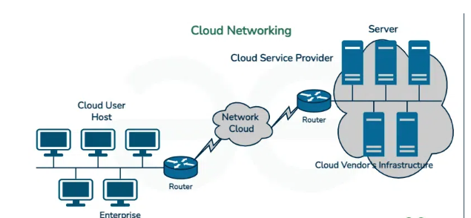
Cloud Networking
Cloud Networking is a service in which a company’s networking procedure is hosted on a public or private cloud.
Cloud Computing is source management in which more than one computing resources share an identical platform and customers are additionally enabled to get entry to these resources to a specific extent.
Cloud networking facilitates organizations to establish secure, scalable, and high-performance network architectures following to their specific requirements.
It involves implementing virtualized networking technologies, such as virtual private clouds (VPCs), software-defined networking (SDN), and load balancing, to ensure reliable connectivity, efficient resource utilization, and seamless integration with cloud services.

Slide 18
The Role of Networking in Cloud Computing
Networking involves the connection of computers, servers, and devices to enable communication and resource sharing.
Cloud computing, networking facilitates the transfer of data between cloud service providers’ data centers, users, and other components of the cloud infrastructure.
Networking plays an important role in various aspects of cloud computing:
Connecting Data Centers
Cloud computing providers use networks to interconnect their data centers, which are the physical locations where cloud services are hosted.
These networks facilitate the transfer of data and enable resource sharing between data centers, ensuring high availability, fault tolerance, and scalability of cloud services.

Slide 19
The Role of Networking in Cloud Computing
2. Delivering Cloud Services
Networks are crucial for delivering cloud services to users. Cloud providers utilize various network technologies, including the internet, private networks, and dedicated connections, to ensure the efficient transfer of data between their infrastructure and end-users.
These networks enable users to access cloud services from anywhere, at any time, with minimal latency.
3. Securing Cloud Computing Environments
Networking plays a significant role in securing cloud computing environments. Cloud providers implement network-level security measures such as firewalls, virtual private networks (VPNs), and intrusion detection systems (IDS) to protect against unauthorized access, data breaches, and other security threats.
Networks also facilitate traffic monitoring and encryption to ensure the confidentiality and integrity of data within the cloud infrastructure.

Slide 20
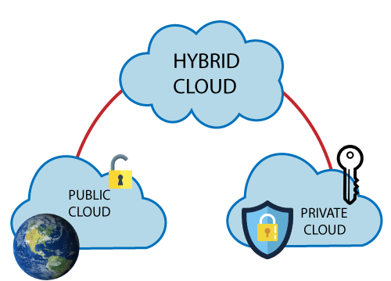
Cloud deployment models
Cloud deployment Model

Slide 21
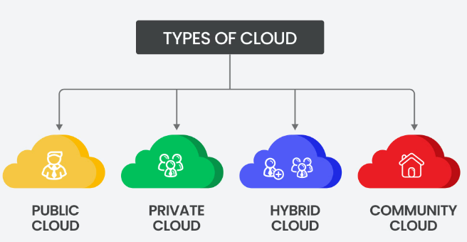
Cloud deployment models
It is often defined as the place where the deployment will take place.

Slide 22
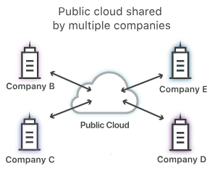
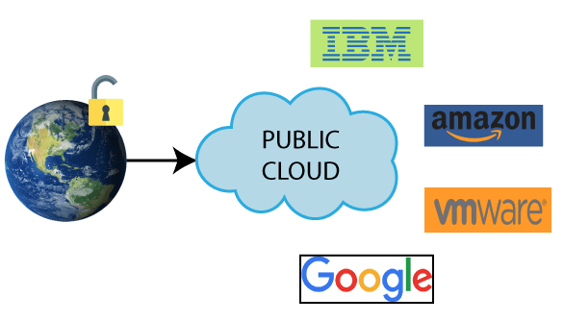
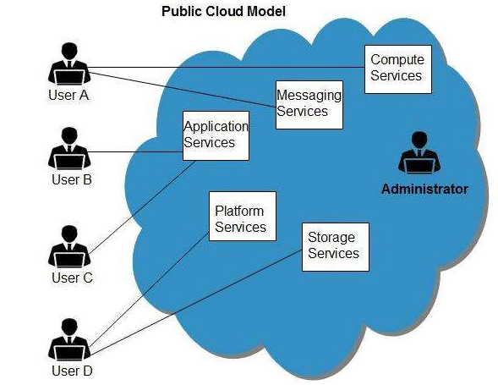
Public cloud
We all live in the public cloud, whether we notice it or not.
For instance, we use Gmail (being a part of Google Cloud Platform) for communicating with clients or co-workers.
We save our data in Google Drive or Dropbox. We create documents online using Google docs. We share our selfies with friends through Facebook or Instagram.
But have we ever wondered where our data, whether it’s emails, files from your computer, online documents or selfies, is stored?

Slide 23
Public cloud
All of this content is kept in the public cloud, i.e. they are stored on a server somewhere in the world – and we are simply accessing it (e.g. Gmail) by using your web browser as a client.
Public cloud means IT services such as data storage, servers, databases, networking, and software that are available for everyone to use. These services are offered by third-party providers over the public internet so that every customer is able to access them via web-based tools and applications.
Public cloud deployments are usually housed on public servers that are accessible over the internet or through VPN service.
The hardware and software used in these facilities are typically owned by the service owner.
This saves a huge amount of money for companies that do not want to buy their own application server, storage, CPU, OS, database and etc.

Slide 24
It also allows you to easily expand and add new services without having to hire more people.
Most of all, public clouds are used for file-sharing, e-mail services, application development, and testings.
Today, workforces can work and access data from almost anywhere in the world, redefining how many companies operate and collaborate.
Public cloud storage options also provide enhanced security and backup capabilities.
In the case of server failure or corruption, data uploaded to the cloud remains intact.

Slide 25
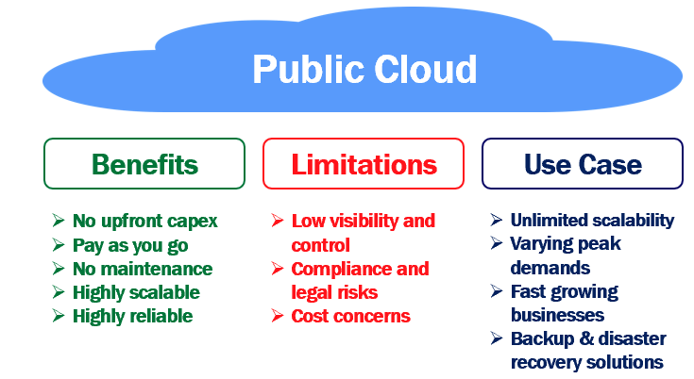

Slide 26
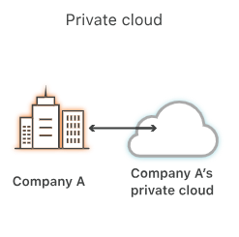
Private cloud
A private cloud is private to one organization. In other words, a private cloud resources and services are used exclusively by one business or organization.
A private cloud is a computing model that offers a secure and dedicated environment for a single business.
All the hardware infrastructure and software are solely dedicated to one organization. It is a single-tenant infrastructure. It is like an internal server of a company
In a private cloud, it's very easy to customize the hardware and software to meet your organization's specific IT requirements. This is because our organization, owns everything i.e the hardware, software and network. So we have complete control and can change anything in any way we want to meet our organization requirements.
In general, private clouds are often used by government agencies, financial institutions and any other medium to large-sized organizations with business-critical operations seeking enhanced control over their environment.

Slide 27
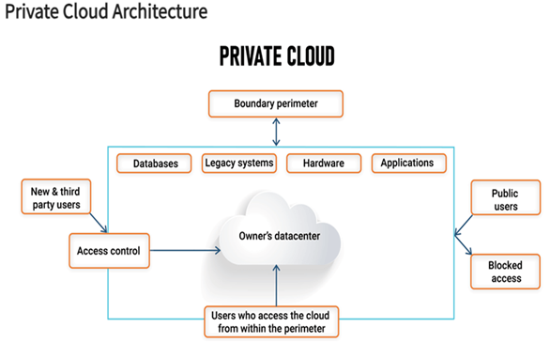
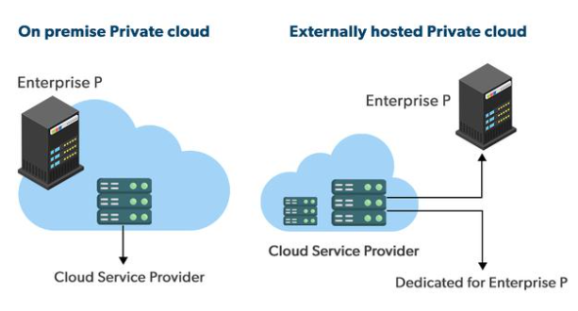

Slide 28
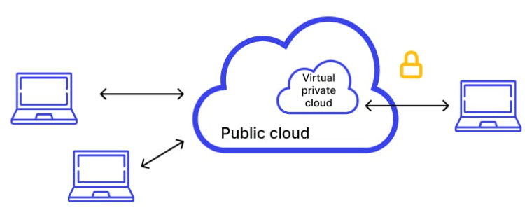
Types of Private Cloud
1. Internal Private Cloud
An internal private cloud is present at the organization’s local data center. All the resources are owned by the organization itself. This allows more control over the resources of the organization. Internal Private Cloud will not be connected to the internet as it is on-premises, and it can be connected through internal networks like data centers. The capital expenditure in this model is high. It is difficult to scale and offers higher latencies as servers are deployed on-premises.
2. External Private Cloud/Managed Private Cloud
An external private cloud is hosted by a third-party cloud provider for the organization. They dedicate resources on behalf of the organization. External Private Cloud can establish connectivity over the public internet but over a VPN (Virtual Private Network), Fiber, or Ethernet. This gives lesser control to the organization. The capital expenditure in this model is low and expenses are variable. It is easy to scale and offers lower latencies as servers can be deployed in different locations.

Slide 29
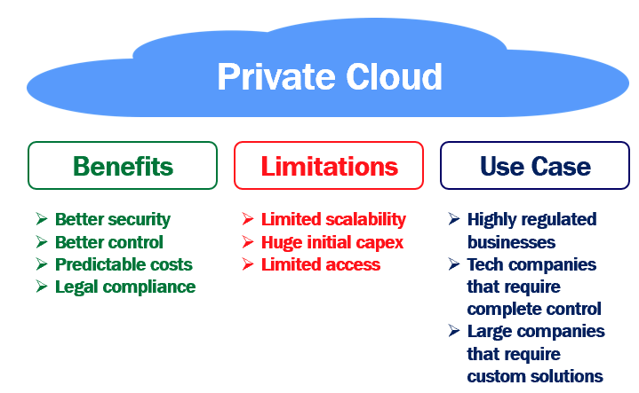

Slide 30
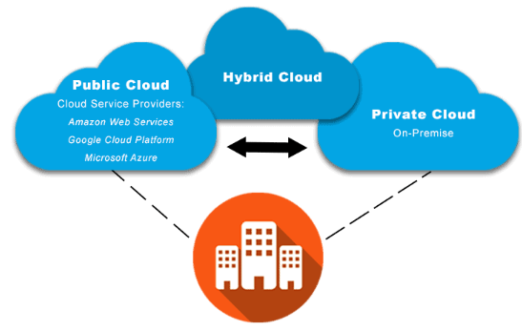
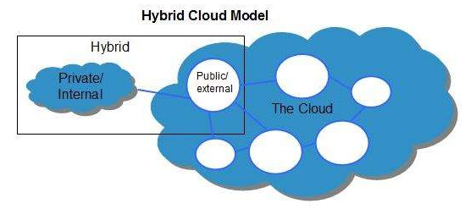
Hybrid cloud
Hybrid Cloud is a mixture of public and private cloud. Non-critical activities are performed using public cloud while the critical activities are performed using private cloud. It allows instant transfer of information between environments, allowing enterprises to experience the benefits of both environments.
For example,
For backup and disaster recovery purposes, a private cloud can be used as a local backup solution ensuring immediate on-site access to corporate data (and its protection) – especially in the context of GDPR compliance.
On the other hand, the public cloud can function as the secondary off-site backup location that provides disaster recovery in the event of on-premises equipment failures.

Slide 31
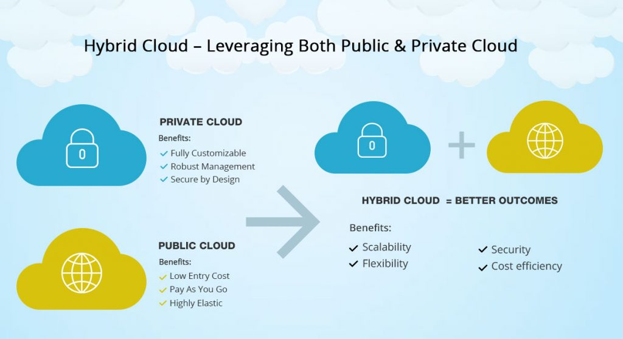
Features and Benefits of the Hybrid Cloud Model
Scalability: Moving non-sensitive functions to the public cloud allows customers to achieve seamless scalability
while also reducing the demands on the private cloud.
Flexibility: Customers can explore different operational avenues and achieve efficient management of their databases and applications on account of the flexibility offered by the hybrid cloud.
Security: The hybrid cloud model not only ensures the security required for sensitive operations but also satisfies the data handling and storage regulatory requirements, wherever applicable.
Cost efficiency: Hybrid clouds enable greater cost efficiency through centralized management

Slide 32
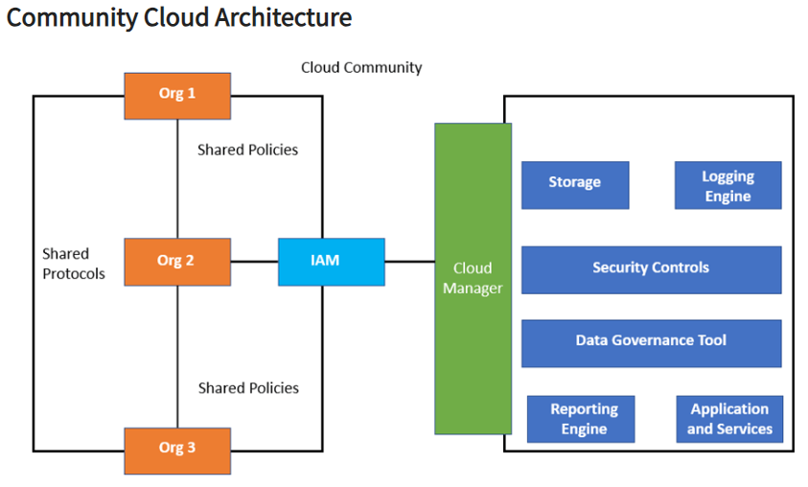
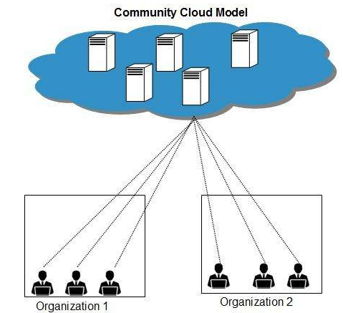
Community cloud
Identity Access Management
Members of the community cloud are essentially organizations with similar business needs.
Community cloud allows systems and services to be accessible by a group of several organizations to share the information between the organization and a specific community.
It is owned, managed, and operated by one or more organizations in the community, a third party, or a combination of them.
The banking sector is one of the best examples that use Community cloud services.
The planning strategy might differ while adopting the Community Cloud. Still, the members will share the same security features and maintain privacy, performance, and compliance requirements.
Examples: Public and Government sectors, Educational institutions, Health care industry

Slide 33
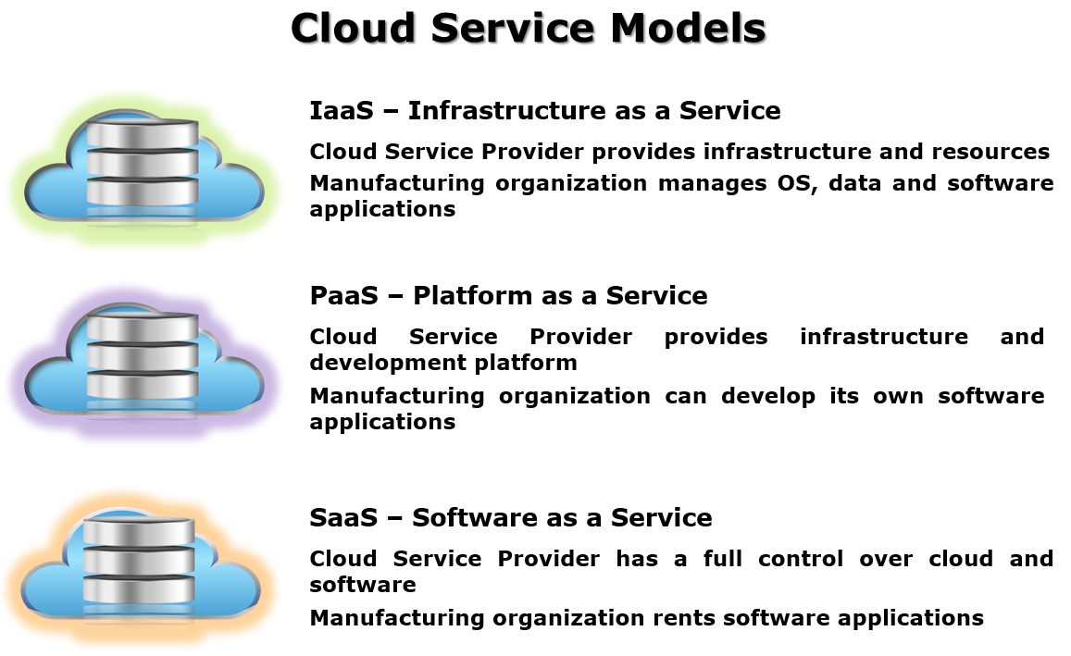
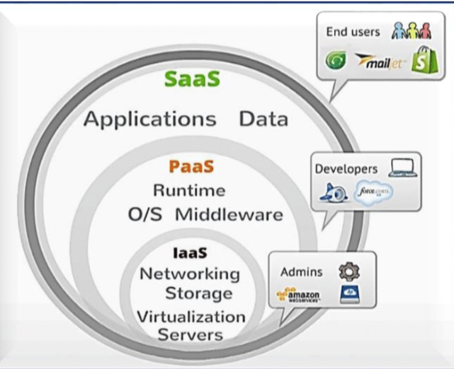
Layers of Cloud / Cloud service models / Cloud Computing service models
There are three layers of cloud computing services
Infrastructure as a Service (IaaS)
Platform as a Service (PaaS)
Software as a Service (SaaS)

Slide 34
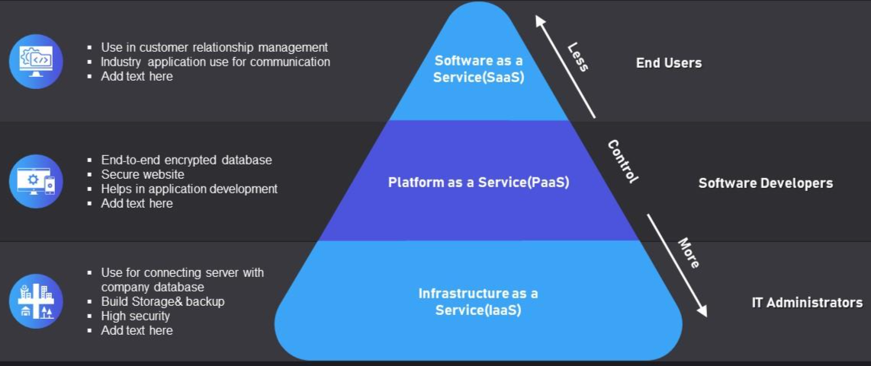
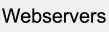
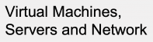

Slide 35
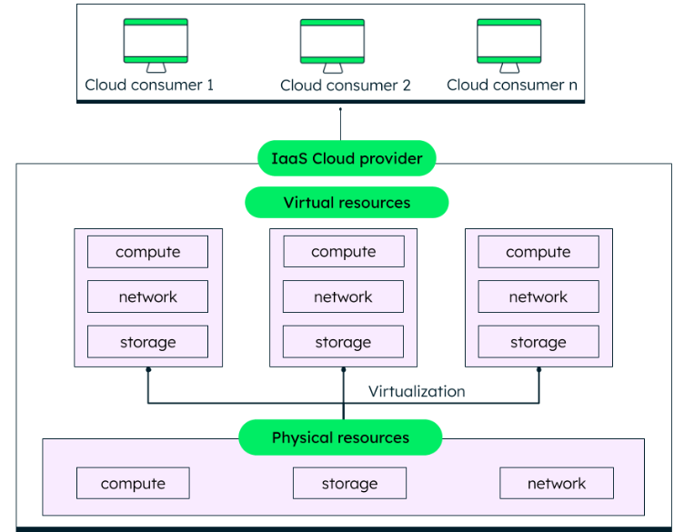
Infrastructure as a Service (IaaS): Building Blocks of the Cloud
All the physical resources or hardware—like laptops, desktops, cables, switches, routers, data centers, and storage devices—are a part of infrastructure. In cloud computing, all the infrastructure is virtualized and provided to consumers as a service. This is called IaaS.
IaaS provides organizations with good control and management on their applications, without having to maintain the infrastructure, i.e., the physical resources.

Slide 36
Infrastructure as a Service (IaaS): Building Blocks of the Cloud
Infrastructure as a Service (IaaS) is a fundamental layer of cloud computing
IaaS delivers cloud computing infrastructure, including servers, network, operating systems, and storage, on-demand, usually on a pay-as-you-go basis through virtualization technology.
While IaaS gives you virtualized resources such as servers, disks, networks, and IP addresses, we are still responsible for administering the operating system, data, applications, middleware and runtimes.
These cloud servers are typically provided to the organization through a dashboard or an API, giving IaaS clients complete control over the entire infrastructure.
IaaS provides the same technologies and capabilities as a traditional data center without having to physically maintain or manage all of it. The IaaS provider handles and manage the servers, hard drives, networking, virtualization, storage, system maintenance, software updates, backup and security

Slide 37
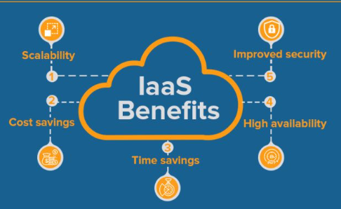
This service was seen was in Gmail, the Google email service where each user gets around 8 GB of free storage. In order to do this, Google built gigantic data centers consisting of (probably) millions of servers.
Examples of IaaS
Rackspace, Amazon Web Services (AWS) Elastic Compute Cloud (EC2), Microsoft Azure,
Google Compute Engine (GCE) and Joyent.

Slide 38
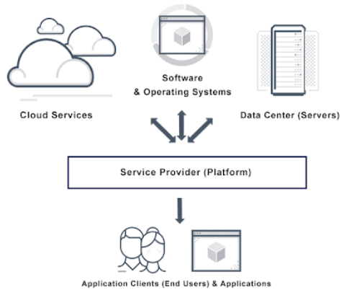
Platform as a Service (PaaS) Empowering Developers
PaaS specifically provides a platform for customers to develop, run, and manage applications.
PaaS can be delivered in three different formats.
It supplies the networking, operating system (OS), middleware (e.g. Java runtime, .NET runtime, integration, etc.), database and other services to host the consumer’s application.
cloud service from the provider. In this configuration, the customer controls software deployment with minimal configuration options.
PaaS configuration can be run as software deployed on public infrastructure as a service such as AWS

Slide 39
Platform as a Service (PaaS) Empowering Developers
The second layer of the cloud is the platform – the PaaS (Platform as a service) where a third-party provider delivers hardware and software tools to users over the internet. Usually, these tools are needed for developing customized software - for example application development and testing
A PaaS provider hosts the hardware and software on its own infrastructure. With PaaS, developers can focus on building their applications without having to worry about operating systems, software updates, storage or infrastructure.
We get a “platform” with built-in software components for both hardware and software such as runtime libraries, tools, applications, email and HTTP servers. This allows developers to rapidly develop, run, and manage their own apps without having to build and maintain the infrastructure
This setup significantly reduces the overhead costs of app development. It also makes it possible for distributed teams of developers to work together on an app from anywhere in the world
Examples of PaaS may include
runtimes such as Java runtimes,
databases such as mySQL or Oracle, and
web servers such as Tomcat.
Another example is Google App Engine, on which one can develop applications and let them execute on Google’s platform. Other commonly-cited examples include AWS Elastic Beanstalk, Windows Azure, Heroku, Force.com, and Apache Stratos.

Slide 40
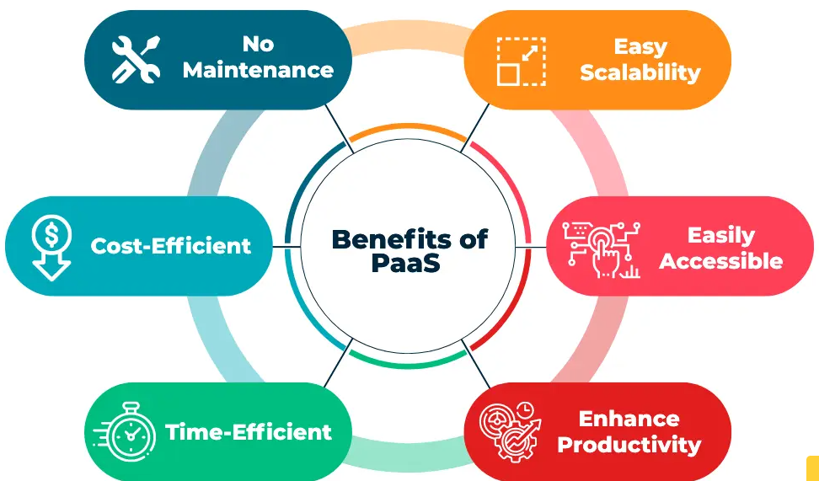

Slide 41
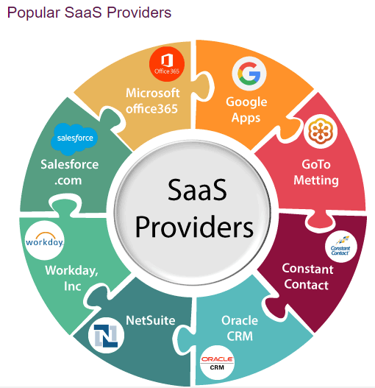
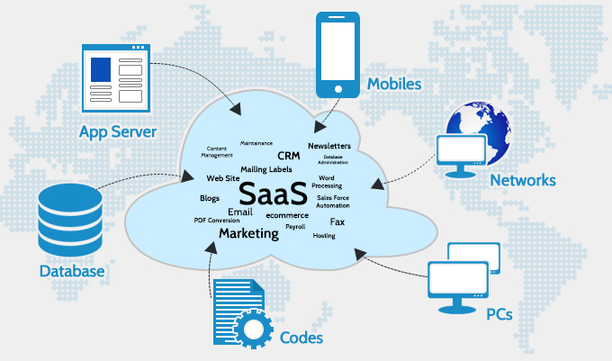
Software as a Service (SaaS): Ready-to-Use Applications
Software-as–a-Service (SaaS) model allows to provide software application as a service to the end users. It refers to a software that is deployed on a host service and is accessible via Internet. Instead of installing and maintaining software, we simply access it via the Internet, freeing yourself from complex software and hardware management.
There are several SaaS applications

Slide 42
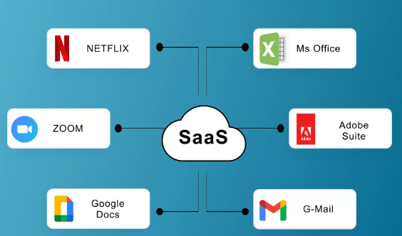
Software as a Service (SaaS): Ready-to-Use Applications
Software as a Service (SaaS) is a web-based software deployment model that makes the software accessible through a web browser. As a user of SaaS software, we don’t care where the software is hosted, which operating system it uses, or which language it is written in.
The SaaS software is made accessible from any device as long we have an internet connection. With SaaS, we do not incur the capital cost of buying servers or software.
The service provider shields us from software maintenance and we simply connect to the SaaS application via a console dashboard or API.
Examples would include Microsoft Office 365, Intuit, Salesforce CRM, Zoom, ZoomInfo, Dropbox, Google Apps and many more that are for consumption by end-users.

Slide 43
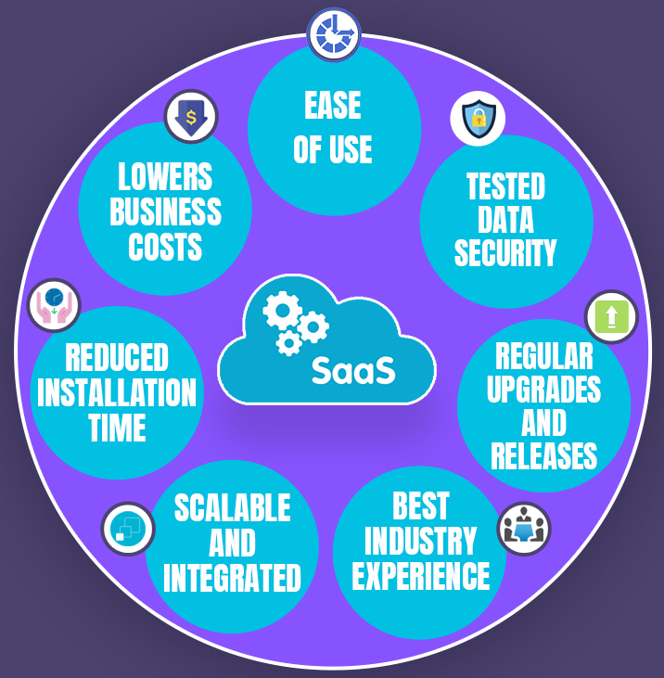
Benefits of SaaS
These applications run on the cloud and need not be downloaded to a local device.
Web mail such as Outlook, Gmail, Yahoo, etc., is one of the earliest forms of SaaS.
SaaS makes it easy for us to focus on our core business. It is a great option for businesses that don’t have the staff or bandwidth to handle software installation and updates.

Slide 44
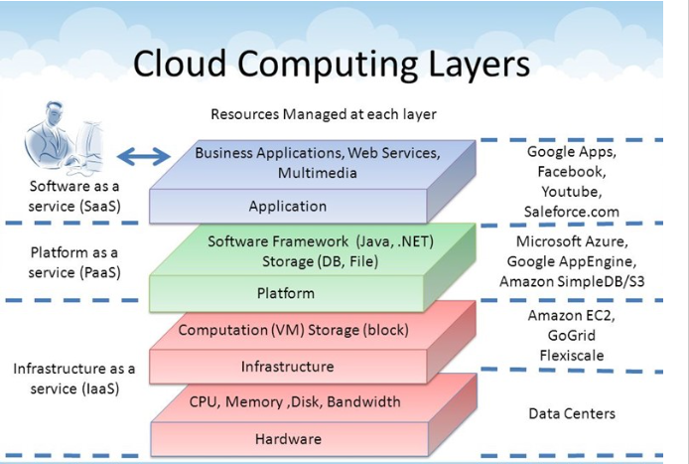
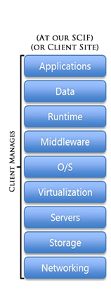
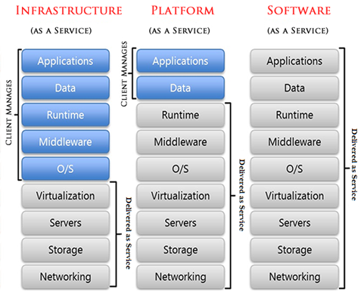

Slide 45
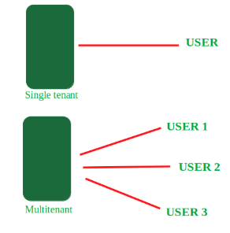
Multitenancy in Cloud computing:
Multitenancy is a type of software architecture where a single software instance can serve multiple distinct user groups.
It means that multiple customers of cloud vendor are using the same computing resources.
As they are sharing the same computing resources but the data of each Cloud customer is kept totally separate and secure.
In cloud computing Multitenancy also refer as shared host where same resources are divided among different customer’s.

Slide 46
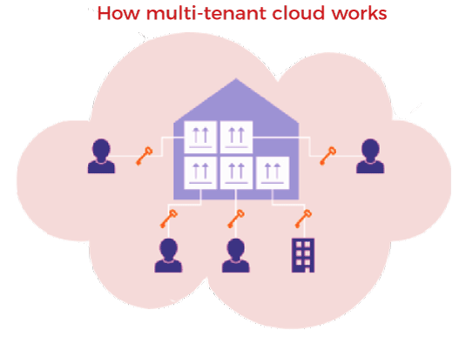
Advantages of Multitenancy :
The use of Available resources is maximized by sharing resources.
Customer's Cost of Physical Hardware System is reduced, and it reduces the usage of physical devices and thus power consumption and cooling cost savings.
Save Vendor's cost as it becomes difficult for a cloud vendor to provide separate Physical Services to each individual.
Disadvantages of Multitenancy :
Data is stored in third-party services, which reduces our data security and puts it into vulnerable conditions.
Unauthorized access will
cause damage to data.

Slide 47
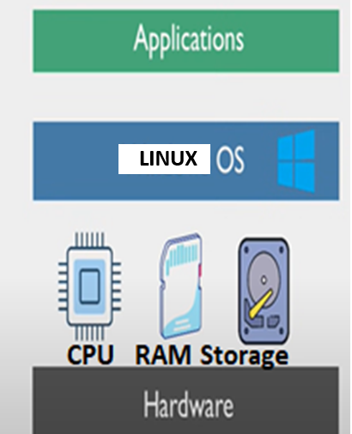
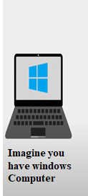
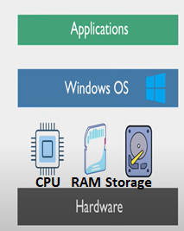

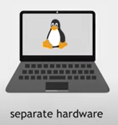
Suppose you want to Learn Linux
To help in reducing the number of physical machines needed for IT operations, saving on purchase costs, physical maintenance we are going for a Technology called Virtualization

Slide 48
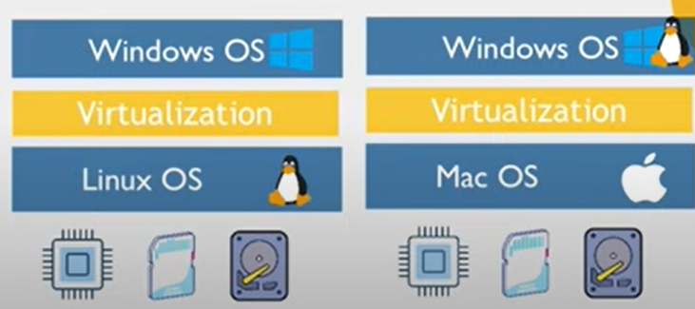
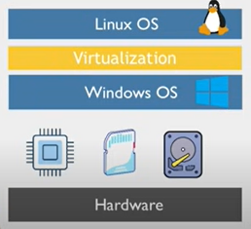
Virtualization
Virtualization is technology that you can use to create virtual representations of servers, storage, networks, and other physical machines called Virtual Machine
With Virtualization no need of separate hardware
Virtual software mimics the functions of physical hardware to run multiple virtual machines simultaneously on a single physical machine.

Slide 49
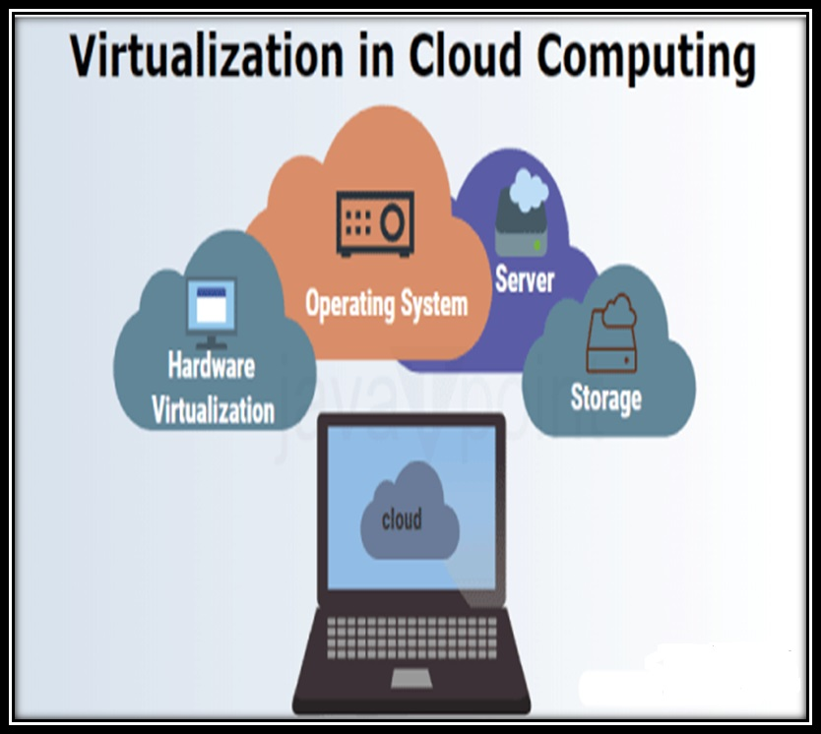
Virtualization
What is Virtualization?
Virtualization is technology that you can use to create virtual representations of servers, storage, networks, and other physical machines.
Virtual software mimics the functions of physical hardware to run multiple virtual machines simultaneously on a single physical machine.
Businesses use virtualization to use their hardware resources efficiently and get greater returns from their investment.
It also powers cloud computing services that help organizations manage infrastructure more efficiently.

Slide 50
Virtualization
Why is virtualization important?
You can interact with any hardware resource with greater flexibility.
Physical servers consume electricity, take up storage space, and need maintenance.
You are often limited by physical proximity and network design if you want to access them. Virtualization removes all these limitations by abstracting physical hardware functionality into software.
You can manage, maintain, and use your hardware infrastructure like an application on the web.

Slide 51
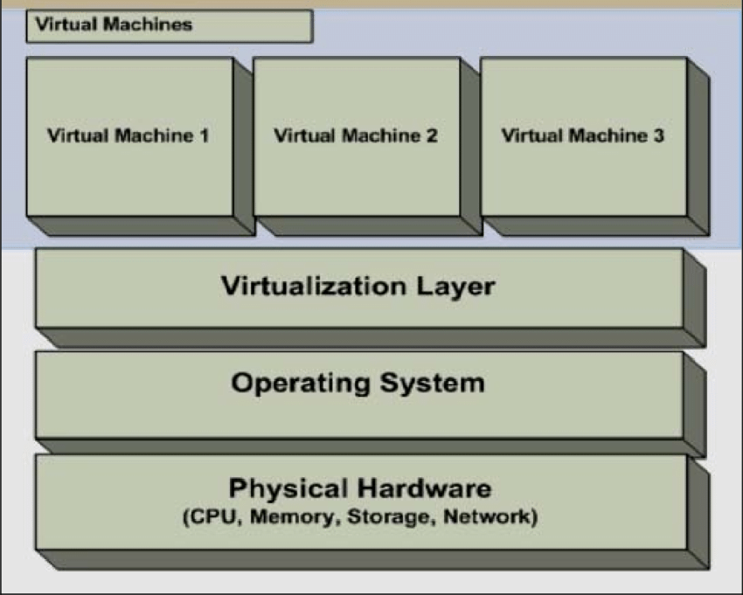
Virtualization Architecture
The architecture of virtualization in cloud computing involves the following components.

Slide 52
Virtualization Architecture
Physical Hardware:
Physical hardware includes the physical parts of a computer, such as the central processing unit (CPU), random access memory (RAM), motherboard, computer data storage, graphics card, sound card, and computer case. It includes external devices such as a monitor, mouse, keyboard, and speakers.
Operating System:
An operating system (OS) is system software that manages computer hardware and software resources, and provides common services for computer programs.
Time-sharing operating systems schedule tasks for efficient use of the system and may also include accounting software for cost allocation of processor time, mass storage, peripherals, and other resources.

Slide 53
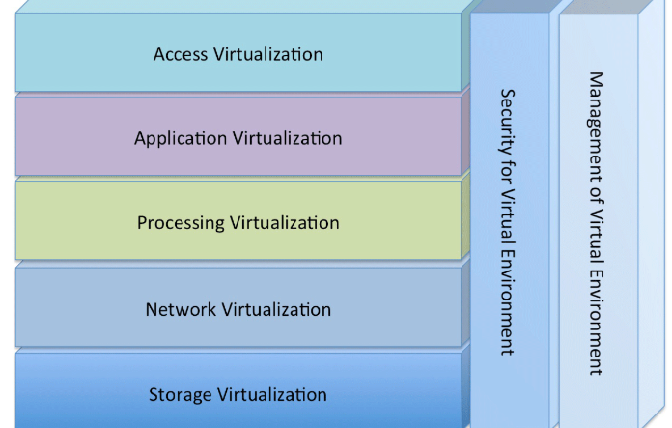
Virtualization Architecture
Virtualization Layer:
The Virtualization layer has 7 layers:
Access Virtualization: Allows applications to work with remote client devices without change, even though those remote devices were never been thought of or available when the application was written. This is called access virtualization.
Application Virtualization: Allows applications written for one OS version or OS to happily execute in another environment; this environment can be a new OS version or an entirely different OS. This is called application virtualization.
Process Virtualization Layer 3: Allows one system to support workloads as if it was many systems, or allows one workload to run across many systems as if it was a single computing resource. This is called processing virtualization

Slide 54
Virtualization Architecture
Virtualization Layer:
4. Storage Virtualization: Allows workloads to access storage without having to know where the data is stored, what type of device is storing the data, or whether the storage is attached directly to the system hosting the workload, or to storage in the cloud. This is called storage virtualization.
5. Network Virtualization: Allows systems to work with other systems safely and securely, without having to care too much about the details of the underlying network. This is called network virtualization .

Slide 55
Virtualization Architecture
Virtualization Layer:
6. Management of Virtual Environment: Allows IT administrators and operators to easily monitor and manage virtual environments across boundaries. The boundaries can include the physical location of systems; OSes in use; applications or workloads in use; network topology; storage implementation; and how client systems connect to the applications. This is called management of virtualized environments
7. Security for Virtual Environment: Monitors and protects all of the other layers of virtualization so that only authorized use can be made of the resources. Yes, this is called security for virtualized environments

Slide 56
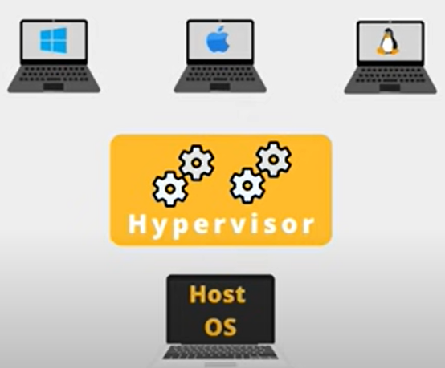
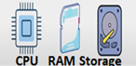

Virtual Machines(VM) and hypervisors
To Create this Virtualization Layer we have a software called Hypervisors
VM1 VM2 VM3
GUEST Machine
Software to manage the VM
HOST Machine

Slide 57
Virtualization Architecture
Hypervisor
The hypervisor is a software component that manages multiple virtual machines in a computer.
It ensures that each virtual machine gets the allocated resources and does not interfere with the operation of other virtual machines.
Virtual machine:
A virtual machine is a software-defined computer that runs on a physical computer with a separate operating system and computing resources. The physical computer is called the host machine and virtual machines are guest machines. Multiple virtual machines can run on a single physical machine. Virtual machines are abstracted from the computer hardware by a hypervisor.
From the user’s perspective, the virtual machine operates like a typical server. It has settings, configurations, and installed applications. Computing resources, such as CPUs, RAM, and storage appear the same as on a physical server. You can also configure and update the guest operating systems and their applications as necessary without affecting the host operating system.

Slide 58


You can give resources to Virtual Machine with what actually you have in the host machine.
For eg if you have total 8GB RAM in the host machine and host machine is utilizing 4GB then the remaining 4GB RAM can be shared among the Virtual Machines we create.
Virtual Machines are completely Isolated - If something breaks in one virtual machine, it will not affect the Host machine and other VMs.
Break

Slide 59


Types of Virtualization

Slide 60

Types of Virtualization
In cloud computing, there are several types of virtualization techniques. Each type of virtualization has a specific purpose and plays a crucial role in building flexible and scalable cloud environments. The main types of virtualization in cloud computing are:
Server Virtualization:
Server virtualization is the process of creating multiple virtual servers on a single physical server. Virtual servers are isolated from each other and may have different sets of software and operating systems. Since they are consolidated on a single physical machine, you can use resources more efficiently, and save money.
Instead of several servers, the company buys one, powerful Server. There is no need to allocate separate physical machines for mail, files, domain servers, etc.
SERVER

Slide 61

Types of Virtualization
2. Storage Virtualization:
Storage virtualization combines the functions of physical storage devices such as network attached storage (NAS) and storage area network (SAN).
You can pool the storage hardware in your data center, even if it is from different vendors or of different types.
Storage virtualization uses all your physical data storage and creates a large unit of virtual storage that you can assign and control by using management software.
IT administrators can streamline storage activities, such as archiving, backup, and recovery, because they can combine multiple network storage devices virtually into a single storage device.

Slide 62

Types of Virtualization
3. Network Virtualization:
Any computer network has hardware elements such as switches, routers, and firewalls.
An organization with offices in multiple geographic locations can have several different network technologies working together to create its enterprise network.
Network virtualization is a process that combines all of these network resources to centralize administrative tasks. Administrators can adjust and control these elements virtually without touching the physical components, which greatly simplifies network management.

Slide 63

Types of Virtualization
4. Application Virtualization:
In this Virtualization, all the individual elements, characteristics, and information of an application is stored on a server.
This system enables users to access and use the application from this server.
This system basically encapsulates all the elements of a particular application and virtualizes them on another server which enables user access to these applications without the need of actually installing it on the target device.
This virtualization separates the application from the underlying operating system, making it accessible from multiple devices without being directly installed on them.
For example, users can run a Microsoft Windows application on a Linux machine without changing the machine configuration.
Users can access and interact with the application from any device connected to the network

Slide 64

Types of Virtualization
5. Desktop Virtualization:
The entire desktop operating system, applications, and data are hosted on a cloud server, and users can access their desktop from any device over the internet.
The desktop environments, also called virtual machines (VMs), are housed on powerful servers that can host several desktop sessions concurrently.
Users can access these VMs on their devices as and when required, regardless of the specifications of their devices.
Desktop virtualization is especially useful for enterprises as it offers a consistent desktop experience to all employees.
IT teams responsible for managing a company’s devices can now manage and issue updates centrally.
Virtual desktops also minimize the security risks associated with employees storing the company data locally. And, since most of the data is stored on servers, device failure will not result in any major loss.

Slide 65

Types of Virtualization
6. Data Virtualization:
This is the kind of virtualization in which the data is collected from various sources and managed at a single place without knowing more about the technical information like how data is collected, stored & formatted then arranged that data logically so that its virtual view can be accessed by its interested people and stakeholders, and users through the various cloud services remotely. Many big giant companies are providing their services like Oracle, IBM, At scale, Cdata, etc.

Slide 66

Hypervisor
Hypervisor:
The hypervisor is a software component that manages multiple virtual machines in a computer. It ensures that each virtual machine gets the allocated resources and does not interfere with the operation of other virtual machines.
There are two types of hypervisors.
Type 1 hypervisor
Type 2 hypervisor

Slide 67


Hypervisor
Type 1 hypervisor (bare-metal hypervisor) :
A type 1 hypervisor, or bare-metal hypervisor, is a hypervisor program installed directly on the computer’s hardware instead of the operating system.
Therefore, type 1 hypervisors have better performance and are commonly used by enterprise applications.
KVM uses the type 1 hypervisor to host multiple virtual machines on the Linux operating system.

Slide 68


Hypervisor
Type 2 hypervisor (hosted hypervisor) :
Also known as a hosted hypervisor, the type 2 hypervisor is installed on an operating system. Type 2 hypervisors are suitable for end-user computing.
A type 2 hypervisor, or hosted hypervisor, interacts with the underlying host machine hardware through the host machine’s operating system. You install it on the machine, where it runs as an application.
The type 2 hypervisor negotiates with the operating system to obtain underlying system resources. However, the host operating system prioritizes its own functions and applications over the virtual workloads.

Slide 69

KVM Hypervisor
KVM (Kernel-based Virtual Machine)
It is an open-source hypervisor that allows a Linux system to act as a host for virtual machines (VMs).
It is built directly into the Linux kernel and turns it into a Type 1 (bare-metal) hypervisor, providing the ability to run multiple virtualized environments on a physical server.
KVM was announced in 2006 and merged into the Linux kernel a year later.
As KVM is the part of Linux Kernal it has all the components .
Every VM is implemented as a regular Linux process, scheduled by the standard Linux scheduler, with dedicated virtual hardware like a network card, graphics adapter, CPU(s), memory, and disks.

Slide 70
Features of KVM
1. Security boundaries with SELinux and sVirt
KVM uses a combination of Security-Enhanced Linux (SELinux) and sVirt for enhanced VM security and isolation. SELinux establishes security boundaries around VMs. sVirt extends SELinux’s capabilities, allowing Mandatory Access Control (MAC) security to be applied to guest VMs and preventing manual labeling errors.
2. Storage flexibility
KVM is able to use any storage format supported by Linux, including some local disks and network-attached storage (NAS).
3. Support for multiple hardware architectures
KVM can run on a wide variety of hardware platforms. KVM uses hardware-assisted virtualization a special features build in the modern processor(such as Intel VT-x and AMD-V) to improve the efficiency and performance of virtual machines (VMs).
4. Live migration
KVM supports live migration, which is the ability to move a running VM from one physical host to another without shutting down or interrupting the VM's operation.. The VM remains powered on, network connections remain active, and applications continue to run while the VM is relocated. KVM also saves a VM's current state so it can be stored and resumed later.

Slide 71
KVM Hypervisor
Why is KVM important?
High performance
KVM is engineered to manage high-demanding applications seamlessly. All guest operating systems inherit the high performance of the host operating system—Linux. The KVM hypervisor also allows virtualization to be performed as close as possible to the server hardware, which further reduces process latency.
Security
Virtual machines running on KVM enjoy security features native to the Linux operating system, including Security-Enhanced Linux (SELinux). This ensures that all virtual environments strictly adhere to their respective security boundaries to strengthen data privacy and governance.

Slide 72
KVM Hypervisor
Stability
KVM has been widely used in business applications for more than a decade. It enjoys excellent support from a thriving open-source community. The source code that powers KVM is mature and provides a stable foundation for enterprise applications.
Cost efficiency
KVM is free and open source, which means businesses do not have to pay additional licensing fees to host virtual machines.
Flexibility
KVM provides businesses many options during installations, as it works with various hardware setups. Server administrators can efficiently allocate additional CPU, storage, or memory to a virtual machine with KVM. KVM also supports thin provisioning, which only provides the resources to the virtual machine when needed.

Slide 73

Xen Hypervisor
The Xen hypervisor, is the open source open-source type-1 or baremetal hypervisor, it supports a wide range of guest operating systems including Windows, Linux, Solaris
The Xen hypervisor is the lowest and most privileged software layer. This layer supports one or more guest operating systems, scheduled on the physical CPUs. The first guest operating system, called in Xen terminology domain 0 (dom0) is executed automatically when the hypervisor boots and receives special management privileges and direct access to all physical hardware by default. The system administrator can log into dom0 in order to manage any additional guest operating systems, called user domains (domU) in Xen terminology.

Slide 74

Xen supports two types of virtualization.
Para Virtualization:
In the para virtualization the kernel of the guest operating system modified to run on the hypervisor hypervisor is a program that runs on the host system at ring 0 therefore is also called a modified guest.
The normal goal of virtualization is to fool the guest OS kernel into thinking it’s running on the real hardware. But in para virtualization, the guest OS knows that it is running in a virtual machine and cooperates with the hypervisor to get access to the actual hardware. The hypervisor contains a set of paravirtualized (PV) drivers that the guest loads instead of the actual hardware drivers.
Fully Virtualization:(HVM- hardware assisted virtualization)
This one is known as hardware assisted virtualization, provides support for unmodified guest operating systems. The guest operating system runs unmodified and does not need to be aware of the hypervisor. The hypervisor emulates the hardware, so the guest OS believes it is running directly on physical hardware, even though it is running in a virtualized environment.

Slide 75
Features of Xen Hypervisors:
Consolidation
Rapid provisioning
Dynamic fault tolerance against software failures (through rapid bootstrapping or rebooting)
Increased utilization
Ability to support legacy software as well as new OS instances on the same computer.
Ability to securely separate virtual operating systems
Hardware fault tolerance (through migration of a virtual machine to different hardware)
Citrix and Oracle use Xen for their virtualization products. Citrix co-opted the Xen name but rebranded XenServer as Citrix Hypervisor to differentiate it from the open source offering. Support for virtual desktops remains a high priority for Citrix, and XenServer has been optimized for that type of workload.
Xen pros:
A true Type 1 hypervisor that provides lower overhead due to having direct access to the hardware.
Xen cons:
No ability to share resources of an underlying OS.
No support for sVirt.

Slide 76

Vmware Hypervisor
VMware is a company that specializes in virtualization and cloud computing technology. The company develops software that enables businesses to create and manage virtualized IT environments, including hypervisors, which are essential for running virtual machines (VMs).
VMware offers several hypervisors, each designed for different use cases, ranging from enterprise data centers to personal or developer environments.
The primary hypervisors in VMware’s are:
1. VMware ESXi
VMware ESXi is a data-center-focused Type 1 or "bare metal" hypervisor, replacing the primary operating system that would interact with a computer's physical components. ESXi, a larger hypervisor that used more of the host computer's resources.
Large-scale enterprise data centers, cloud infrastructures, and virtualized environments use this hypervisor

Slide 77
VMware vSphere Hypervisor
VMware vSphere Hypervisor is a Type 1 or "bare metal" hypervisor. It is essentially a free version of VMware ESXi. It provides essential virtualization capabilities but lacks some of the advanced features available in the full vSphere suite, such as centralized management (vCenter) and certain enterprise features.
It's suitable for small businesses or individuals who need basic virtualization features.
3. VMware Workstation hypervisor
VMware Workstation is a Type 2 hypervisor. It is designed for desktop and developer environments. It runs on top of an existing operating system (e.g., Windows or Linux) and allows users to create and run multiple VMs on a single physical machine. Workstation is popular among developers, testers, and IT professionals who need to run different operating systems on a single host machine.
It is used for Desktop virtualization, software development, testing, and learning environments.
4. VMware Fusion
Similar to VMware Workstation, VMware Fusion is designed specifically for macOS users. It enables Mac users to run virtual machines with other operating systems (such as Windows, Linux, and others) alongside macOS. Fusion is ideal for running virtualized environments on Mac computers for development, testing, and educational purposes.
It is used for Virtualization on Mac computers, development, and testing

